Slide 1
Pervasive Computing & Jaringan Sensor
INTEGRATED Frontier Areas IN INFORMATION TECHNOLOGY
Compiled by WW

Slide 2
Evaluasi
Tugas1
UTS (40 %)
Tugas 2
Final Project
Resources
Ubiquitous Devices , Stephen Postlad
Wireless Sensor Networks Books
Paper and Book
Intelligent Computing (Object , Activity Recognition Etc)
Sensor and Distributed Programming
Programming Communications for Wireless Networking
Laboratory Work
Arduinno, Android, Wireless (NRF2401, Zigbee, Bluetooth, WIFI, Mobile Communitaion ( Network) Programming , SMS) etc

Slide 3
Pervasive Computing
Pervasive computing is the evolution of distributed computing in which networked computing devices are integrated throughout the personal and work environments in a connected way, also referred to as ubiquitous computing
Pervasive computing is the use of computing devices everywhere and these devices communicate with each other over wireless networks without any interactions required by the user.

Slide 4
Pervasive Computing Cont
A technology environment that supports nomadic workers using wireless networking, context awareness, personalization, and human-device interaction
Technology that has moved beyond the personal computer to everyday devices with embedded technology and connectivity. The goal of pervasive computing is to create an environment where the connectivity of devices is embedded in such a way that the connectivity is unobtrusive and always available.
Pervasive computing or ubiquitous computing, as the name indicates, refers to the trend toward increasingly connected computing devices in the environment. The devices need not be computers, but very tiny (even invisible) and either mobile or embedded in almost any type of object, including cares, clothing, and appliances

Slide 5
Ubiquitous Computing
Ubiquitous computing (ubicomp) is a post-desktop model of human-computer interaction in which information processing has been thoroughly integrated into everyday objects and activities.

Slide 6
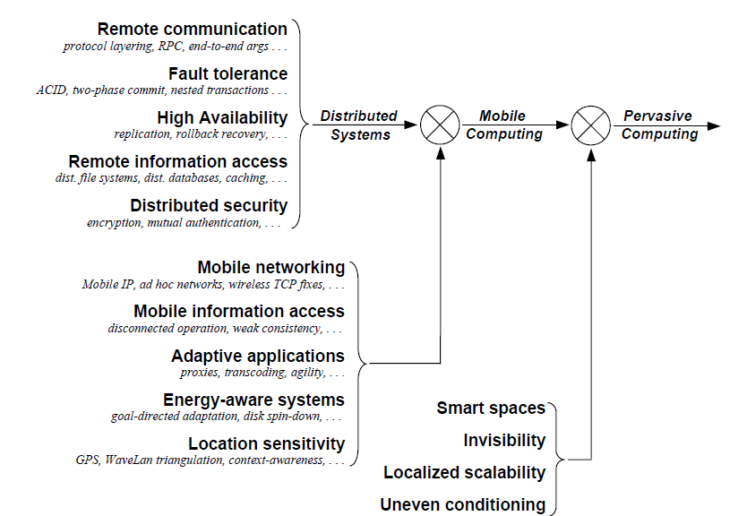

Slide 7
Distributed Pervasive Systems
Observation: There is a next-generation of distributed systems emerging in which the nodes are small, mobile, and often embedded as part of a larger system. Some requirements:
Contextual change: The system is part of an environment in which changes should be immediately accounted for.
Ad hoc composition: Each node may be used in a very different ways by different users. Requires ease-of-configuration.
Sharing is the default: Nodes come and go, providing sharable services and information. Calls again for simplicity.
Observation: Pervasiveness and distribution transparency may not always form a good match.
Notes:
Distributed pervasive systems are often characterized by being small, battery-powered, mobile, and having only a wireless connection, although not all these characteristics apply to all devices.

Slide 8
Pervasive Systems: Examples (1/2)
Home Systems: Should be completely self-organizing:
There should be no system administrator
Provide a personal space for each of its users
Simplest solution: a centralized home box?
Electronic health systems: Devices are physically close to a person:
Where and how should monitored data be stored?
How can we prevent loss of crucial data?
What infrastructure is needed to generate and propagate alerts?
How can security be enforced?
How can physicians provide online feedback?

Slide 9
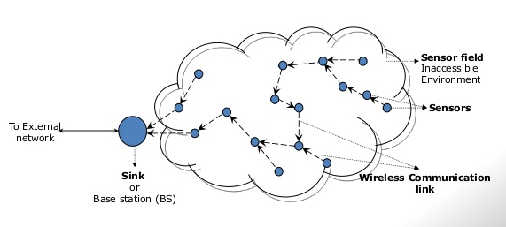
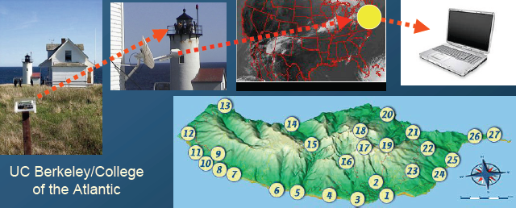
Background of Research
Wireless Sensor Network (WSN)
a network that consists of spatially distributed autonomous sensor nodes with limited resources (e.g powered by limited battery , cpu, small memory) and coordinate by message passing through limited wireless connections (bandwidth/speed)
Intel Research Laboratory/ College of the Atlantic in Bar Harbor a/University of California at Berkeley to deploy wireless sensor networks on Great Duck Island, Maine (in 2002)

Slide 10
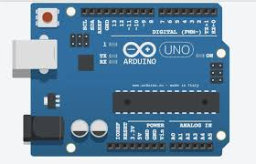
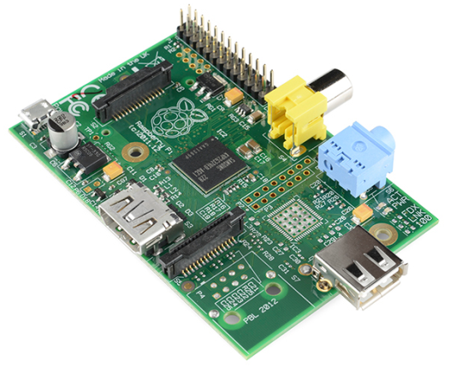

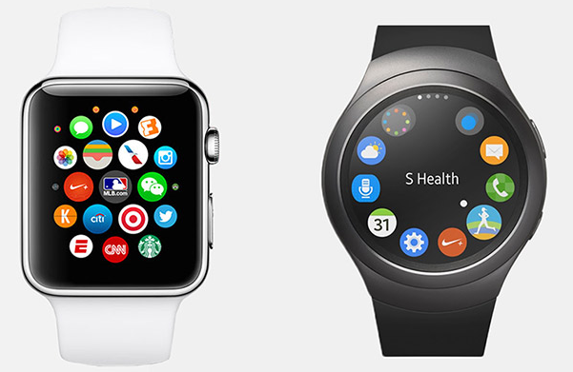

Slide 11
Sensor networks (2/2)
Characteristics: The nodes to which sensors are attached are:
Many (10s-1000s)
Simple (i.e., hardly any memory, CPU power, or communication facilities)
Often battery-powered (or even battery-less)
Sensor networks as distributed systems: consider them from a database perspective:
Notes:
A sensor network typically consists of tens to hundreds or thousands of relatively
small nodes, each equipped with a sensing device. Most sensor networks
use wireless communication, and the nodes are often battery powered. Their limited
resources, restricted communication capabilities, and constrained power consumption
demand that efficiency be high on the list of design criteria.
The relation with distributed systems can be made clear by considering sensor
networks as distributed databases. This view is quite common and easy to understand
when realizing that many sensor networks are deployed for measurement
and surveillance applications (Bonnet et aI., 2002). In these cases, an operator
would like to extract information from (a part of) the network by simply issuing
queries such as "What is the northbound traffic load on Highway I?" Such
queries resemble those of traditional databases. In this case, the answer will probably
need to be provided through collaboration of many sensors located around
Highway 1, while leaving other sensors untouched.
To organize a sensor network as a distributed database, there are essentially
two extremes, as shown in Fig. 1-13. First, sensors do not cooperate but simply
send their data to a centralized database located at the operator's site. The other
extreme is to forward queries to relevant sensors and to let each compute an
answer, requiring the operator to sensibly aggregate the returned answers.

Slide 12
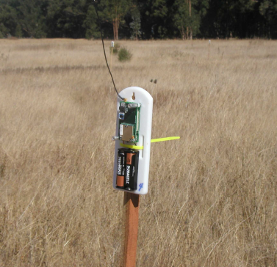
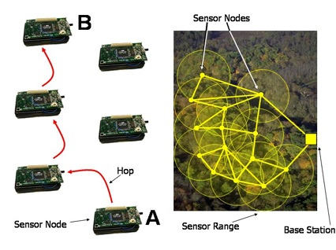
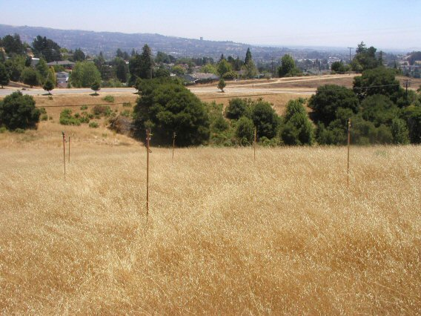
Goal of WSN deployments
Wireless Sensors Networks (WSN) are commonly deployed in an ad hoc manner for special purposes e.g. environmental, wild life monitoring
FIREBUG : WSN for Predictive Analysis of Bust Fire Behaviors
A project by University of California, Berkeley CA.
SENSNET http://automatica.dei.unipd.it/research/networked-control-systems.html

Slide 13
Challenges of Wireless Sensor Network
Sensor Nodes and Network Lifetime
Sensor nodes are battery-powered (life time is very crucial)
Each operation brings the node closer to death.
May lead to isolated / disconnected network regions
Low Bandwidth Wireless Communication
The data should be sensed, aggregated and transferred to the sink node (base station) in an effective ways
transmit and receive only if necessary (minimize energy consumed by transmission )
prevent congested network, disconnected network (due to possible death node(s) in the path ways) through aggregation
activity (e.g. as sensing should be perform effectively)

